Slide 1
CSC 112: Computer Operating Systems Lecture XX Virtual Memory
Department of Computer Science,
Hofstra University

Slide 2
Agenda
Virtual Memory Intro
Page Tables
Translation Lookaside Buffer
Demand Paging
System Calls
Summary

Slide 3
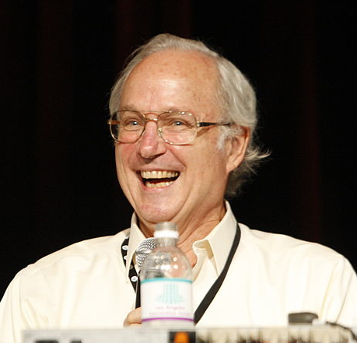
Overarching Theme for Today
“Any problem in computer science can be solved by an extra level of indirection.”
Often attributed to Butler Lampson (Berkeley PhD and Professor, Turing Award Winner), who in turn, attributed it to David Wheeler, a British computer scientist, who also said “… except for the problem of too many layers of indirection!”
Butler Lampson

Slide 4
Virtualizing Resources
Physical Reality: Different Processes/Threads share the same hardware
Need to multiplex CPU (finished: scheduling)
Need to multiplex use of Memory (Today)
Need to multiplex disk and devices (later in term)
Why worry about memory sharing?
The complete working state of a process and/or kernel is defined by its data in memory (and registers)
Probably don’t want different processes to have access to each other’s memory (protection)
Notes:
Consequently, cannot just let different threads of control use the same memory
Physics: two different pieces of data cannot occupy the same locations in memory

Slide 5
Review: Memory Management
The processor’s view of memory (eg, using the C programming language)
Static storage: global variable storage, basically permanent, entire program run
Stack: local variable storage, parameters, return address
Heap (dynamic storage): malloc() grabs space from here, free() returns it
~ FFFF FFFF_{hex}
stack
heap
global data
code
~ 0_{hex}

Slide 6
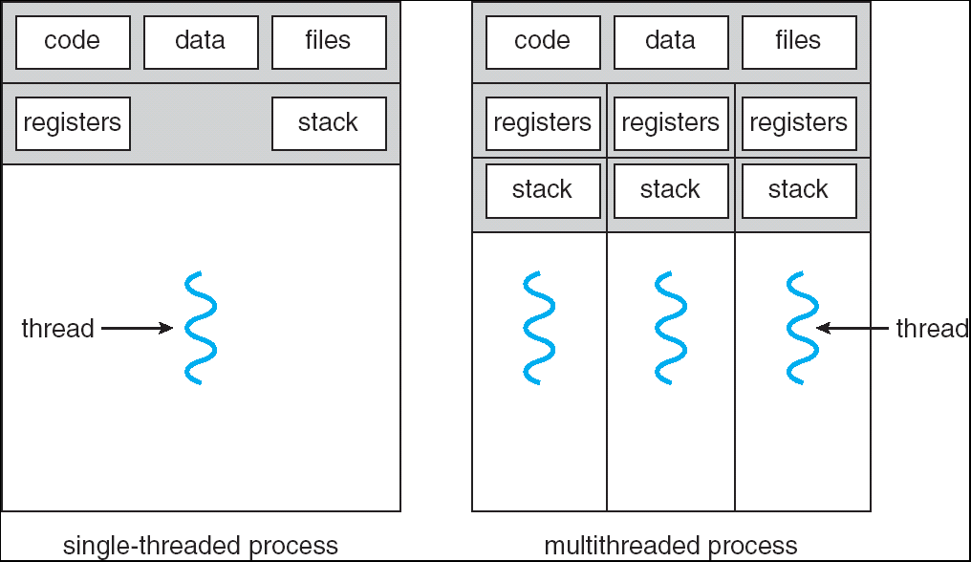
Recall: Single and Multithreaded Processes
Threads encapsulate concurrency
“Active” component of a process
Address spaces encapsulate protection
Keeps buggy program from trashing the system
“Passive” component of a process

Slide 7
Important Aspects of Memory Multiplexing
Controlled overlap:
Separate state of threads should not collide in physical memory. Obviously, unexpected overlap causes chaos!
Conversely, would like the ability to overlap when desired (for communication)
Translation:
Ability to translate accesses from one address space (virtual) to a different one (physical)
When translation exists, processor uses virtual addresses, physical memory uses physical addresses
Side effects:
Can be used to avoid overlap
Can be used to give uniform view of memory to programs
Protection:
Prevent access to private memory of other processes
Different pages of memory can be given special behavior (Read Only, Invisible to user programs, etc).
Kernel data protected from User programs
Programs protected from themselves

Slide 8
Uniprogramming
Uniprogramming (no Translation or Protection)
Application always runs at same place in physical memory since only one application at a time
Application can access any physical address
Application actually is given a dedicated machine
0xFFFFFFFF
Operating
System
Valid 32-bit
Addresses
Application
0x00000000
Notes:
Simplest Model: Only one program running on the computer
Addresses in the program are exactly the physical memory addresses

Slide 9
The Problem
What if less physical memory than full address space?
32 bit addresses => 4 GB address space, RAM hasn’t always been larger than 4 GB.
64 bit addresses => 16 exibytes.
What if we want to run multiple programs at the same time?

Slide 10
The Problem
Limited physical memory, one or more programs each with their own address space.
~ FFFF FFFF_{hex}
stack
~ FFFF FFFF_{hex}
stack
heap
heap
static data
static data
code
code
Physical Memory
~ 0_{hex}
~ 0_{hex}
Application 1
Application 2

Slide 11
Multiprogramming (Version with Protection)
Can we protect programs from each other without translation?
Yes: use two special registers base and bound to prevent user from straying outside designated area
If user tries to access an illegal address, cause an error
During switch, kernel loads new base/bound from TCB
User not allowed to change base/bound registers
0xFFFFFFFF
Operating
System
Bound=0x10000
0x00020000
Base=0x20000
Application2
Application1
0x00000000
Notes:
Location-independent programs
Programming and storage management ease: need for a base register
Protection
Independent programs should not affect each other inadvertently: need for a bound register
Historically, base + bounds registers were a very early idea in computer architecture

Slide 12
Idea #1: Segmentation
Location-independent programs
Program doesn’t need to specify its absolute memory addresses; need for a base register
Protection
Independent programs should not affect each other inadvertently: need for a limit (or bound) register
Notes:
Example: 10K Instructions between I/O – 100K Instructions during I/O. Programming and storage management ease:

Slide 13
Segmentation Hardware
Segment Length
Limit
Register
≤
Bounds
Violation?
Physical
Address
current
segment
lw …
Physical Memory
Effective
Address
+
Base
Register
Base Physical Address
Program
Address
Space
Use base and limit registers to perform address translation.
Trap to OS if bounds violation detected (“seg fault”/”core dump”)

Slide 14
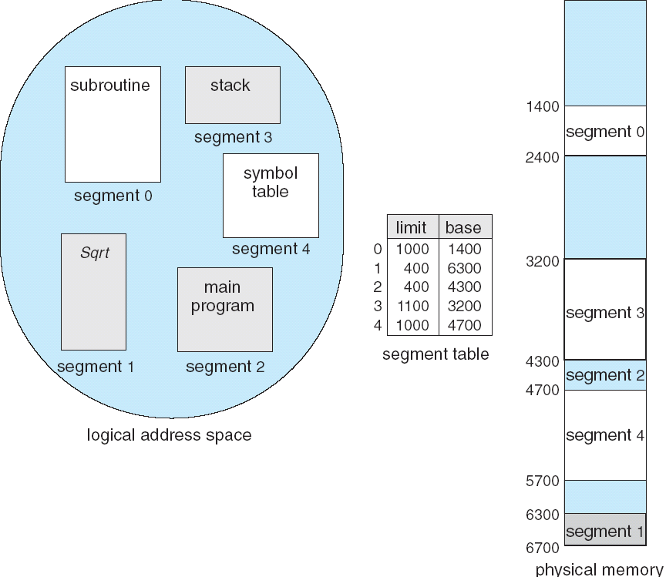
Segmentation Example
Animation: http://cs.uttyler.edu/Faculty/Rainwater/COSC3355/Animations/segmentation.htm

Slide 15
Processes Sharing Physical Memory
procs 4 & 5
arrive
procs 2 & 5
leave
OS
Space
OS
Space
OS
Space
proc 1
16K
proc 1
16K
proc 1
16K
proc 2
24K
proc 2
24K
24K
proc 4
Free memory space
24K
16K
proc 4
16K
8K
8K
proc 3
32K
proc 3
32K
proc 3
32K
24K
proc 5
24K
24K
As processes come and go, the storage is “fragmented”. Therefore, at some stage processes have to be moved around to compact the storage.
Notes:
Called Burping the memory. Easy way to do this?
Animation: http://cs.uttyler.edu/Faculty/Rainwater/COSC3355/Animations/multiplepartcma.htm

Slide 16
Agenda
Virtual Memory Intro
Page Tables
Translation Lookaside Buffer
Demand Paging
System Calls
Summary

Slide 17
Idea #2: Page Tables to avoid Fragmentation
Divide memory address space into equal sized blocks, called pages
Page: a unit of memory translatable by memory management unit (MMU)
Traditionally 4 KB or 8 KB
Use a level of indirection to map program addresses into physical memory addresses
One indirection mapping per address space page
This table of mappings is called a Page Table
Address Space (Process) switch: change pointer to base of table (hardware register)
Notes:
Page: a unit of memory translatable by memory management unit (MMU)
Typically 1K – 8K
Page table structure in memory
Each process has a different page table
Address Space (Process) switch: change pointer to base of table (hardware register)

Slide 18
Processes and Virtual Memory
Address Space:
Each process has its own memory address space
Give each program the illusion that it has its own private memory
Program addresses called virtual addresses
Space of all virtual addresses called virtual memory
Divided into pages indexed by Virtual Page Number (VPN).
Memory addresses called physical addresses
Space of all physical addresses called physical memory
Divided into pages indexed by Physical Page Number (PPN).
Notes:
Each program called a Process, like a thread but has its own memory space.
Each has own PC, stack, heap
All the addresses and state a process can touch
each program has a different view of memory.
Allows multiple processes to simultaneously occupy memory and provides protection – don’t let one process read/write memory from another

Slide 19
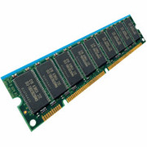
Two Views of Memory
CPU
Virtual
Addresses
Physical
Addresses
MMU
Two views of memory:
View from the CPU (what program sees, virtual memory)
View from memory (physical memory)
Memory management unit (MMU) converts between the two views
Translation helps to implement protection
The same virtual address in different processes is mapped to different physical addresses, hence different processes cannot read/write each other’s memory
Every program can be linked/loaded into same region of user address space
Isolation achieved through translation, not relocation
Notes:
If task A cannot even gain access to task B’s data, no way for A to adversely affect B

Slide 20
Paged Memory Systems
Virtual memory address is split into:
Offset refers to which byte in the page.
Page # refers to which page in address space.
Page Table maps VPN to PPN, a page in physical memory.
Virtual Page Number Offset
32-bit memory address
4KB pages
20 bits
12 bits
Notes:
Relaxes the contiguous allocation requirement.

Slide 21
Paged Memory Systems
Page table contains the physical address of the base of each page:
0
0
1
0
This Address Space
consists of 8x 4K Byte pages or
16768 Bytes
1
2
2
2
3
3
1
4
4
Physical Memory
5
5
6
6
7
3
7
Page Table
(contains
VPN => PPN
mapping)
4
Virtual Address Space
7
Page tables make it possible to store the pages of a program non-contiguously.
Notes:
Relaxes the contiguous allocation requirement.

Slide 22
Address Translation via Page Table
virtual address
Virtual Page Number
Page Offset
valid
Physical Page Number
page
table
physical address
Physical Page Number
Page Offset
Generally, VPN has more bits than PPN, since physical memory is smaller (# virtual pages ≥ # physical page)
Page offset determines page size, which is the same for both virtual and physical memory
Notes:
Fully associative
Q: Why are there no tag bits?
A:

Slide 23
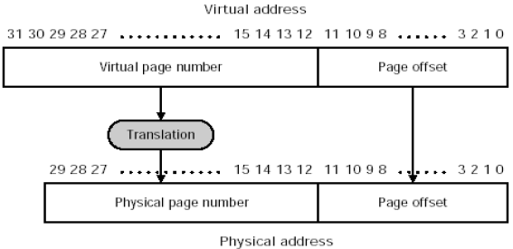
Addr Translation Example
Virtual Address: 32 bits
Physical Address: 29 bits
Page size: 2^12=4KB
Note: Page offset here refers to byte address within a page (e.g., 4KB); compare with byte offset we discussed in caching, which refers to byte address within a cache/memory block (e.g., 8 Bytes)

Slide 24
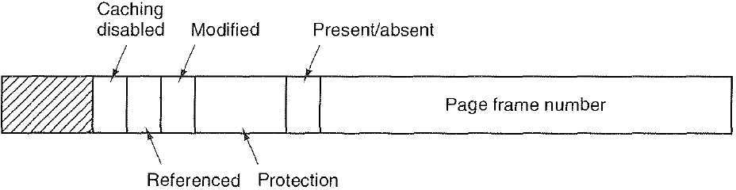
What is in a Page Table Entry (PTE)?
Figure on Slide 24 is simplified. Several Additional bits in PTE
Physical Page Number (PPN), also called Page frame number
Present/absent bit, also called Valid bit. If this bit is 1, the page is in memory and can be used. If it is 0, the page is not currently in memory. Accessing a page table entry with this bit set to 0 causes a page fault to get page from disk.
Protection bits tell what kinds of access are permitted on the page. 3 bits, one bit each for enabling read, write, and execute.
Modified (M) bit, also called dirty bit, is set to 1 when a page is written to
Referenced (R) bit, is set whenever a page is referenced, either for reading or writing.
M and R bits are very useful to page replacement algorithms
Caching disabled bit, important for pages that map onto device registers rather than memory
(Physical)
Other possible bits
Notes:
Protection bits checked on every access to see if allowed
Read: can read, but not write page
Read/Write: read or write data on page
Execute: Can fetch instructions from page
Valid = Valid page table entry
When the virtual page can be found in physical memory.
(vs. found on disk or not yet allocated)
Since page table is indexed by virtual page number, and # virtual pages ≥ # physical page frames, hence no tag bits are needed
Address same format previous slide (10, 10, 12-bit offset)
Intermediate page tables called “Directories”
What is in a Page Table Entry (or PTE)?
Pointer to next-level page table or to actual page
Permission bits: valid, read-only, read-write, write-only
Page table includes a flag (dirty bit) to indicate if the page has been modified since it was last synced with virtual memory.
The flag is reset when the page is saved to virtual memory
When a page is removed from physical memory
If the dirty bit is set it will be written to virtual memory
If the dirty bit is not set it will be abandoned and overwritten
The page table includes a flag to indicate if the page has been accessed.
OS has a paging management time period defined. Each time this time period ends the accessed bit (R bit) for each page is reset to 0
Each time the page is accessed the R bit is set to 1, and the last accessed time is updated to reflect the time of the most recent access

Slide 25
Separate Address Space per Process
Proc 1
OS
pages
VA1
Page Table
Proc 2
VA1
Page Table
Physical Memory
Proc 3
VA1
Page Table
free
Each program has own page table
Page table contains an entry for each program page
Notes:
OS ensures that the page tables are disjoint.

Slide 26
Protection + Indirection = Virtual Address Space
~ FFFF FFFF_{hex}
stack
~ FFFF FFFF_{hex}
stack
7
6
5
4
3
2
1
0
7
6
5
4
3
2
1
0
heap
heap
static data
static data
code
Page Table
Page Table
code
~ 0_{hex}
~ 0_{hex}
Application 1
Virtual Memory
Application 2
Virtual Memory
Physical Memory

Slide 27
Protection + Indirection = Virtual Address Space
~ FFFF FFFF_{hex}
stack
~ FFFF FFFF_{hex}
stack
7
6
5
4
3
2
1
0
7
6
5
4
3
2
1
0
heap
heap
static data
static data
code
Page Table
Page Table
code
~ 0_{hex}
Stack 1
~ 0_{hex}
Application 1
Virtual Memory
Heap 1
Application 2
Virtual Memory
Static 1
Code 1
Physical Memory

Slide 28
Protection + Indirection = Virtual Address Space
~ FFFF FFFF_{hex}
stack
~ FFFF FFFF_{hex}
stack
7
6
5
4
3
2
1
0
7
6
5
4
3
2
1
0
heap
Stack 2
heap
static data
Heap 2
static data
Static 2
code
Page Table
Code 2
Page Table
code
~ 0_{hex}
Stack 1
~ 0_{hex}
Application 1
Virtual Memory
Heap 1
Application 2
Virtual Memory
Static 1
Code 1
Physical Memory

Slide 29
Dynamic Memory Allocation
~ FFFF FFFF_{hex}
stack
~ FFFF FFFF_{hex}
stack
7
6
5
4
3
2
1
0
7
6
5
4
3
2
1
0
Heap’ 1
heap
Stack 2
heap
static data
Heap 2
static data
Static 2
code
Page Table
Code 2
Page Table
code
~ 0_{hex}
Stack 1
~ 0_{hex}
Application 1
Virtual Memory
Heap 1
Application 2
Virtual Memory
Static 1
Code 1
malloc(4097)
Physical Memory

Slide 30
Dynamic Memory Allocation
~ FFFF FFFF_{hex}
stack
~ FFFF FFFF_{hex}
stack
7
6
5
4
3
2
1
0
7
6
5
4
3
2
1
0
Stack’ 2
Heap’ 1
heap
Stack 2
heap
static data
Heap 2
static data
Static 2
code
Page Table
Code 2
Page Table
code
~ 0_{hex}
Stack 1
~ 0_{hex}
Application 1
Virtual Memory
Heap 1
Application 2
Virtual Memory
Static 1
Code 1
malloc(4097)
Physical Memory
Recursive function call

Slide 31
Controlled Sharing
~ FFFF FFFF_{hex}
stack
~ FFFF FFFF_{hex}
stack
7
6
5
4
3
2
1
0
7
6
5
4
3
2
1
0
heap
heap
static data
Stack 2
static data
Heap 2
code
Page Table
Static 2
Page Table
code
~ 0_{hex}
Stack 1
~ 0_{hex}
Application 1
Virtual Memory
Heap 1
Application 2
Virtual Memory
Static 1
Code
Physical Memory
Shared Code Page
“X” Protection Bit

Slide 32
Controlled Sharing
~ FFFF FFFF_{hex}
stack
~ FFFF FFFF_{hex}
stack
7
6
5
4
3
2
1
0
7
6
5
4
3
2
1
0
heap
heap
static data
static data
Stack 2
code
Page Table
Heap 2
Page Table
code
~ 0_{hex}
Stack 1
~ 0_{hex}
Application 1
Virtual Memory
Heap 1
Application 2
Virtual Memory
Static
Shared Globals
“RW” Protection
Bits
Code
Physical Memory
Shared Code Page
“X” Protection Bit

Slide 33
Address Translation & Protection
Virtual Address
Virtual Page No. (VPN)
offset
Kernel/User Mode
Read/Write
Protection
Check
Address
Translation
Exception?
Physical Address
Physical Page No. (PPN)
offset
Every instruction and data access needs address translation and protection checks
Animation: http://cs.uttyler.edu/Faculty/Rainwater/COSC3355/Animations/paginghardware.htm
http://cs.uttyler.edu/Faculty/Rainwater/COSC3355/Animations/pagingmodel.htm
http://cs.uttyler.edu/Faculty/Rainwater/COSC3355/Animations/pagingexample.htm

Slide 34
Where Should Page Tables Reside?
Space required by the page tables is proportional to the address space, number of users, …
Space requirement is large: e.g., 2³² byte virtual address space, 4K(2¹²)byte page size = 2²⁰ PTEs (per process)
If each PTE is 4 bytes, then total bytes 4 * 2²⁰ = 4MB
Each process has its own page table. Suppose 50 processes running on a system, then 200MB of memory used for page tables!
Notes:
= 1024 x 1024 entries (per process!)
How many bits per page table entry?
Too expensive to keep in processor registers! 20 bits of address + valid bit: use 4 bytes

Slide 35
Where Should Page Tables Reside?
Too large to keep in cache. Keep in main memory
Keep physical address of page table in Page Table Base Register.
One access to retrieve the physical page address from table.
Second memory access to retrieve the data word
Doubles the number of memory references!
Use TLB to avoid the double memory access (later)
What if Page Table doesn’t fit in memory?
Multiple levels of page tables, or segmentation + paging (Discussed later)

Slide 36
Page Tables In Physical Memory
PT User 1
VA1
PT User 2
User 1 Virtual Address Space
Physical Memory
VA1
User 2 Virtual Address Space

Slide 37
Segmentation + Paging (Multi-level Translation)
What about a tree of tables?
Lowest level page table⇒memory still allocated with bitmap
Higher levels often segmented
Could have any number of levels. Example (top segment):
Virtual
Address:
Virtual
Seg #
Virtual
Page #
Offset
page #0
V,R
Base0
Limit0
V
page #1
V,R
Physical
Page #
Offset
page #2
V,R,W
Base1
Limit1
V
page #2
V,R,W
Physical Address
Base2
Limit2
V
page #3
V,R,W
Base2
Limit2
V
Base3
Limit3
N
page #4
N
Base4
Limit4
V
page #5
V,R,W
Check Perm
Base5
Limit5
N
Base6
Limit6
N
Base7
Limit7
V
>
Access
Error
Access
Error
37
Notes:
What must be saved/restored on context switch?
Contents of top-level segment registers (for this example)
Pointer to top-level table (page table)

Slide 38
Two-level Page Tables
32-bit address:
1K
PTEs
10
10
12
P1 index
P2 index
page offset
1K
PTEs
4KB
Alternative to segmentation+paging
Often the top-most parts and bottom-most parts of virtual memory are used in running a process - the bottom for text and data segments while the bottom for stack, with free memory in between. The multilevel page table may keep a few of the smaller page tables to cover just the top and bottom parts of memory and create new ones only when strictly necessary (segmentation+paging is similar)
Notes:
See here for an example: http://cs.uttyler.edu/Faculty/Rainwater/COSC3355/Animations/twolevelpaging.htm
Page: a unit of memory translatable by memory management unit (MMU)
Typically 1K – 8K
Page table structure in memory
Each user has different page table
Address Space switch: change pointer to base of table (hardware register)
Hardware traverses page table (for many architectures)
MIPS uses software to traverse table (why?)

Slide 39
Two-level Page Tables Example
Virtual address (32 bits ➔ 4 Gbyte virtual address space)
10 bits root table index 10 bits page table index Offset
4-Kb root
page table
4-Mb user
page table
…
4-Gb user
address space
…

Slide 40
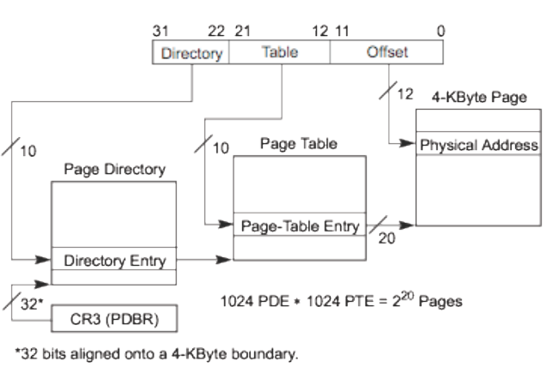
Two-level Page Tables Example
PDBR: Page Directory Base Register
PDE: Page Directory Entry

Slide 41
Inverted Page Tables
As the size of virtual memory address space grows, additional levels must be added to multilevel page tables to avoid that the root page table becomes too large
Assuming 64-bits address space, 4-Kb page size (12 bits for page offset), each page table can store 1024 entries, or 10 bits of address space. Thus ⎡(64-12) /10⎤= 6 levels are required → 6 memory accesses for each address translation
Inverted page tables:
Indexed by PPN instead of VPN → # entries is equal to # PPNs, which is generally much smaller than #VPNs
Notes:
and a PTE of 4 bytes,

Slide 42
Inverted Page Tables
Consider a simple inverted page table
There is one entry per PPN
The table is now shared among the processes, so each PTE must contain the pair <process ID, virtual page #>
In order to translate a virtual address, the VPN and current process ID are compared against each entry, scanning the table sequentially.
If a match is found, its index in the inverted page table is the PPN
If no match is found, a page fault occurs.
Notes:
Physical frame # is not stored, since the index in the table corresponds to it

Slide 43
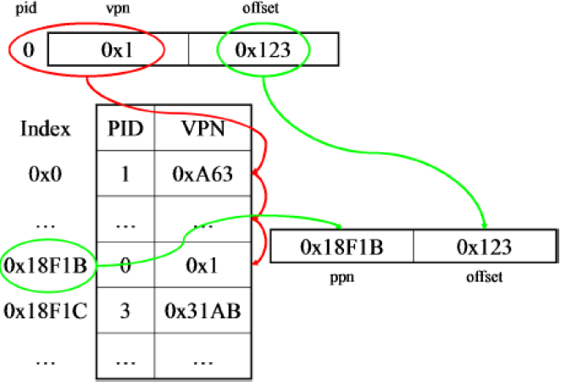
Inverted Page Tables Lookup Example

Slide 44
Inverted Page Tables
The search can be very inefficient since finding a match may require searching the entire table.
Solution: Hashed IPT to reduce # memory accesses (omitted)
Q: Is PPN stored in the table?
A: No, since the table index is PPN. Remember that we are doing a reverse lookup from table entry to table index.
Notes:
Q: IPT is indexed by PPN, why are tag bits not needed?
A: Remember we are trying going VPN → PPN

Slide 45
Agenda
Virtual Memory Intro
Page Tables
Translation Lookaside Buffer
Demand Paging
System Calls
Summary

Slide 46
TLB
Build a separate cache for entries in the Page Table!
For historical reasons, called Translation Lookaside Buffer (TLB)
More accurate name is Page Table Address Cache; should be small enough to fit in L1$.
Looks up Virtual Address; returns Physical Address
Split into T, I, O!
virtual address
VPN offset
V R W X tag PPN
(VPN = virtual page number)
(PPN = physical page number)
hit?
physical address
PPN offset
Notes:
Temporal and Spatial locality of Page Table accesses?
(Not a huge amount of spatial locality since pages are so big)

Slide 47
TLB is Cache
Data at memory address
Virtual Page Number
Physical Page Number
Memory Address
Data / Instruction Cache
TLB
On miss: Access next cache level / main memory
On miss: Access Page Table in memory

Slide 48
What TLB organization makes sense?
CPU
TLB
Cache
Memory
Needs to be really fast
Critical path of memory access
Thus, this adds to access time (reducing cache speed)
Seems to argue for Direct Mapped or Low Associativity
However, needs to have very few conflicts!
With TLB, the Miss Time extremely high!
This argues that cost of Conflict (Miss Time) is much higher than slightly increased cost of access (Hit Time)
Notes:
In simplest view: before the cache
What if use low order bits of page as index into TLB? Each entry maps a large page, hence less spatial locality Typically 32-128 entries
Usually fully/highly associative Thrashing: continuous conflicts between accesses
across pages
First page of code, data, stack may map to same entry
Need 3-way associativity at least?
What if use high order bits as index?
TLB mostly unused for small programs

Slide 49
TLB organization
How big does TLB actually have to be?
Usually small: 128-512 entries
Not very big, can support higher associativity without much performance degradation
TLB is usually fully-associative, but can also be set-associative
Q: Is TLB write-through or write-back?
A: write-through → always keep TLB and page table consistent

Slide 50
TLB: More Details
Cache Page Table Entries in TLB
TLB hit => Single Cycle Translation
TLB miss => Access Page-Table to fill
A memory management unit (MMU) is hardware that walks the page tables and reloads the TLB
Virtual
Address
TLB
Physical
Memory
CPU
Physical
Address
Cached?
Yes
No
Save
Result
Translate
(MMU)
Data Read or Write
(untranslated)
Notes:
3 memory references
2 page faults (disk accesses) + ..
Actually used in IBM before paged memory.

Slide 51
What Actually Happens on a TLB Miss?
On TLB miss, hardware in MMU looks at current page table to fill TLB (may walk multiple levels)
If PTE valid (page present in memory), hardware fills TLB and processor never knows
If PTE marked as invalid (page on disk), causes Page Fault, then kernel gets the page from disk
Example: http://cs.uttyler.edu/Faculty/Rainwater/COSC3355/Animations/pagingtlb.htm
Notes:
Most CPUs provide hardware traversal, but can also do this in software
Software traversed Page tables (like MIPS)
On TLB miss, processor receives TLB fault
Kernel traverses page table to find PTE
If PTE valid, fills TLB and returns from fault
If PTE marked as invalid, internally calls Page Fault handler
Examples:
shared segments
user-level portions of an operating system

Slide 52
Effective Access Time with TLB
TLB lookup time = σ time unit
Memory access time = m time unit
Assume: Page table needs single access (no multilevel page tables)
There is no cache
TLB Hit ratio = η
Effective access time:
EAT = (m + σ) η + (2m + σ)(1 – η) = 2m + σ – m η

Slide 53
Valid & Dirty Bits
TLB entries have valid bits and dirty bits. Data cache blocks have them also.
The valid bit means the same in both: valid = 0 means either TLB miss or cache miss.
The dirty bit has different meanings. For cache, it means the cache block has been changed. For TLBs, it means that the page corresponding to this TLB entry has been changed.

Slide 54
What Happens on a Context Switch?
Recall each process has its own page table and virtual address space; But there is only a single TLB in the system
TLB entries no longer valid upon process context-switch
Options:
Invalidate TLB: set valid bits of all TLB entries to 0
Simple but might be expensive
What if switching frequently between processes?
Include ProcessID in TLB
This is an architectural solution: needs hardware support
Notes:
Need to do something, since TLBs map virtual addresses to physical addresses

Slide 55
Cache Addressing
Cache can be virtually addressed ...
the virtual address is broken into tag-index-offset to look up data in cache
Must either clear cache on context-switch or store Process ID with the Tag.
Address translation only needed upon cache miss
... or physically addressed
the virtual address is first converted to a physical address (using page table)
the physical address is used to find data in cache
Virtually addressed caches are faster, but make sharing data between processes complicated.
Next examples assume physically-addressed cache
Notes:
One compromise is to use virtual address for the index and physical address for the tag
Two options:
Perform address translation BEFORE caching
Cache operates on physical address.
This is mostly what we’ll talk about.
Perform address translation AFTER caching
Cache operates on virtual address.
Must either clear cache on context switch or store Process ID with the Tag.

Slide 56
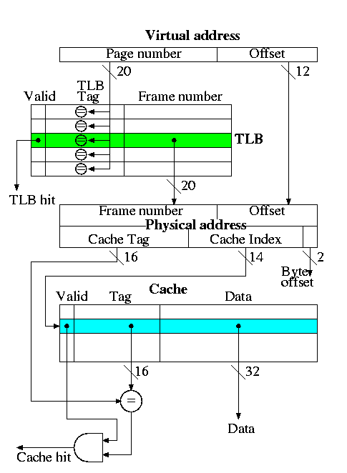
Example
Consider the TLB+Physically-Addressed Cache:
Virtual address = 32 bits
Physical address = 32 bits
Fully associative TLB
Direct mapped cache
Cache blocksize = one word (4 bytes)
Pagesize = 4KB = 2^12 bytes
Cache size = 16K entries = 64KB
Notes:
The page number is searched in the fully associative TLB
If a TLB hit occurs, the frame number from the TLB together with the page offset gives the physical address. A TLB miss causes an exception to reload the TLB, which we do not discuss.
The physical address is broken into a cache tag and cache index (plus a two bit byte offset that is not used for word references).
If the reference is a write, just do it without checking for a cache hit (this is possible because the cache is so simple as we discussed previously).
For a read, if the tag located in the cache entry specified by the index matches the tag in the physical address, the referenced word has been found in the cache; i.e., we had a read hit.
For a read miss, the cache entry specified by the index is fetched from memory and the data returned to satisfy the request.

Slide 57
TLB Lookup Sequence
Virtual Address
hardware
hardware or software
software
Restart instruction
TLB
Lookup
miss
hit
Page Table
Walk
Protection
Check
the page is
∉ Memory ∈ memory
denied
permitted
Page Fault
(OS loads page)
Update TLB
Protection
Fault
Physical
Address
(to cache)
SEGFAULT
Notes:
Need to restart instruction.
Soft and hard page faults.

Slide 58
Sequence for Case of TLB Hit
If a TLB hit occurs, the PPN (Frame Number) from the TLB together with the page offset gives the physical address.
The physical address is broken into a cache tag and cache index (plus a two-bit byte offset that is not used for word references).
For a read, if the tag located in the cache block specified by the index matches the tag in the physical address, we had a read hit.
For a read miss, the cache block specified by the index is loaded from memory to cache
Notes:
VPN (Page Number) is searched in the fully-associative TLB for a Tag match

Slide 59
Address Translation in CPU Pipeline
PC
Inst TLB
Inst. Cache
D
Decode
E
M
Data TLB
Data Cache
W
+
TLB miss? Page Fault?
Protection violation?
TLB miss? Page Fault?
Protection violation?
Need mechanisms to cope with the additional latency of a TLB:
Slow down the clock
Pipeline the TLB and cache access (make it span multiple page stages)
Virtually-addressed cache

Slide 60
Optimization: Concurrent Access to TLB & Phys. Addressed Cache
Cache
Index
VA
VPN I O
TLB
Direct-map Cache
2^{I} blocks
2^{O}-byte block
k
PA
PPN Page Offset
Tag
=
Physical Tag
Data
hit?
Index I is available without consulting the TLB
⇒ cache access and TLB access can begin simultaneously
Tag comparison is made after both accesses are completed to determine cache
hit or miss
Only works if I + O ≤ k (Page Offset has same or more number of bits as Cache Index+Offset)
e.g., won’t work for example on Slide 58 with cache T:I:O=16:14:2
Notes:
Can perform cache lookup in parallel with TLB lookup; compare PPN from TLB lookup with cache tag. match → cache hit; no match → cache miss
Only works if Page Offset has same or more number of bits as Cache Index+Offset.
E.g., this trick won’t work for example on previous slide (cache T:I:O=16:14:2)

Slide 61
Day in the Life of an (Instruction) Address
PA
PA
PC
MEM
Instruction
No Cache, No Virtual Memory
(Note: PA - Physical Address, VA - Virtual Address)

Slide 62
Day in the Life of an (Instruction) Address
VA (VPN, Offset)
PC
PA (PPN, Offset)
PA
TLB
MEM
Hit
Instruction
No Cache, Virtual Memory, TLB Hit

Slide 63
Day in the Life of an (Instruction) Address
VA (VPN, Offset)
PC
TLB
Miss
PTBR
VPN
Page Table Base Register
(Addr of Page Table Entry)
PA (PPN, Offset)
PA
+
D$
MEM
Hit
Instruction
PA Data Cache, Virtual Memory, TLB Miss, Page Table in D$
(NOTE: PA cache means addresses translation before caching)

Slide 64
Day in the Life of an (Instruction) Address
VA (VPN, Offset)
PC
TLB
Miss
PTBR
VPN
Page Table Base Register
+
D$
(Addr of Page Table Entry)
Miss
PA (PPN, Offset)
PA
MEM
MEM
Instruction
PA Data Cache, Virtual Memory, TLB Miss, Page Table not in D$,
PT Access in Memory

Slide 65
Day in the Life of an (Instruction) Address
VA (VPN, Offset)
PC
TLB
Miss
PTBR
VPN
Page Table Base Register
+
D$
(Addr of Page
Table Entry)
Miss
PA
(PPN,
Offset)
Hit
MEM
I$
Instruction
PA Data & Instruction Cache, Virtual Memory, TLB Miss, Page Table not in D$,
PT Access in Memory, Instruction in I$

Slide 66
Day in the Life of an (Instruction) Address
VA (VPN, Offset)
PC
TLB
Miss
PTBR
VPN
Page Table Base Register
+
PA (@Page Table Entry)
D$
Miss
PA (@Page Table Entry)
PA
(PPN,
Offset)
Miss
MEM
I$
PA
MEM
Instruction
PA Data & Instruction Cache, Virtual Memory, TLB Miss, Page Table Access,
Instruction not in I$, Instruction access in Memory
Notes:
What if there’s a page fault?
Day in the life of a data access is not too different

Slide 67
Hit/Miss possibilities
TLB | Page | Cache | Remarks
hit | hit | hit | Possible, page table not checked on TLB hit, data from cache
hit | hit | miss | Possible, page table not checked, cache block loaded from memory
hit | miss | hit | Impossible, TLB references in-memory pages
hit | miss | miss | Impossible, TLB references in-memory pages
miss | hit | hit | Possible, TLB entry loaded from page table, data from cache
miss | hit | miss | Possible, TLB entry loaded from page table, cache block loaded from memory
miss | miss | hit | Impossible, cache is a subset of memory
miss | miss | miss | Possible, page fault brings in page, TLB entry loaded, cache block loaded from memory

Slide 68
Agenda
Virtual Memory Intro
Page Tables
Translation Lookaside Buffer
Demand Paging
System Calls
Summary

Slide 69
Demand Paging
What if required pages no longer fit into Physical Memory?
Think running out of RAM on a machine
Physical memory becomes a cache for disk.
Page not found in memory => Page Fault, must retrieve it from disk.
Memory full => Invoke replacement policy to swap pages back to disk.

Slide 70
Just Another Level in the Memory Hierarchy
Regs
Upper Level
Instr. Operands
Faster
Cache
Blocks
L2 Cache
Blocks
{
Memory
Virtual
Memory
Pages
Disk
Files
Larger
Tape
Lower Level

Slide 71
VM Provides Illusion of a large, private, uniform store
Protection & Privacy
Several users, each with their private address Space and one or more shared address spaces
Demand Paging
Provides ability to run programs larger than the primary memory
Price is address translation on each memory reference;
And disk so slow that performance suffers if going to disk all the time (“thrashing”)
OS
user_{i}
Swapping
Store
Primary
Memory
VA
PA
Mapping
Notes:
Portability on machines with different memory configurations. Hides differences in machine configurations

Slide 72
Historical Retrospective: 1960 versus 2010
Memory used to be very expensive, and amount available to the processor was highly limited
Now memory is cheap: <$10 per GByte
Many apps’ data could not fit in main memory, e.g., payroll
Programmers manually moved the data back and forth from the disk store
Programmers no longer need to worry about this level of detail anymore; OS takes care of it.
Notes:
Paged memory system reduced fragmentation but still required whole program to be resident in the main memory
For good performance, buy enough memory to hold your appsby overlaying it repeatedly on the primary store

Slide 73
Demand Paging in Atlas (1962)
“A page from secondary
storage is brought into the primary storage whenever it is (implicitly) demanded by the processor.”
Tom Kilburn
Primary
(~physical memory)
32 Pages
512 words/page
Primary memory as a cache
for secondary memory
Secondary
(~disk)
32x6 pages
Main
Memory
User sees 32 x 6 x 512 words
of storage
Notes:
Single-level Store

Slide 74
Caching vs. Demand Paging
secondary
memory
CPU
primary
memory
CPU
primary
memory
cache
Caching Demand paging
cache entry page frame
cache block (~32 bytes) page (~4K bytes)
cache miss rate (1% to 20%) page miss rate (<0.001%)
cache hit (~1 cycle) page hit (~100 cycles)
cache miss (~100 cycles) page fault (~5M cycles)
a miss is handled a miss is handled
in hardware mostly in software

Slide 75
Design Issues
Design issues for VM are related to HUGE cost of a miss (page fault)
Accessing disk may take MILLIONS of clock cycles
Cache (SRAM): 5-25ns
Memory (DRAM): 60-120ns
Disk: 10-20 million ns
Page size should be large enough to cover the cost of page fault
transfer time is much less than access time
4KB to 16KB common (newer systems: 32KB - 64KB)
Reducing page fault rate has high priority
fully-associative page placement
write back + write allocate (instead of write though) to minimize writes to disk
Page faults are handled in software by OS
overhead is small compared to cost of disk access
use clever algorithms to minimize page faults
Notes:
Problem with fully-associative mapping: need to search entire set of pages to find a tag match
Full searching is impractical: use page table
Stored in memory
Contains the physical page number for every virtual page number
Each program has its own page table
To assist accessing page table, hardware has page table register; Points to start of page table
Valid bit is used as in cache
Q: On a write, should we write the new value through to (memory/disk) or just keep it in the (cache/memory) and write it back to (memory/disk) when the (cache-block/page) is replaced?
A:
Write-back has fewer writes to (memory/disk) since multiple writes to the (cache-block/page) may occur before the (cache-block/page) is evicted.
For caching, the cost of writing through to memory is less than 100 cycles, so the cost of write through is bearable
For paging, the cost of writing through to disk is on the order of 1,000,000 cycles. Since write-back has fewer writes to disk, it is used.

Slide 76
Quiz: Tag Bits
Q: For a fully-associate cache, tag bits in each cache block are used to disambiguate among multiple candidate memory blocks that can map to the same cache block. For fully-associative page placement, and # virtual pages ≥ # physical page frames → VPN bits ≥ PPN bits. Hence it seems like a Tag field with VPN bits - PPN bits is needed. Why are there no tag bits in each page table entry?
A: The page table performs a one-way translation: it always maps from virtual page to physical page, but not vice versa, hence we do not need to distinguish between multiple possible virtual pages mapped to the same physical page → no need for tags.
Notes:
Deleted--Page table ensures that there is no ambiguity as to “a PPN refers to which VPN”. At any given time, one valid physical memory page can only refer to exactly one possible virtual memory page based on the page table. Hence tag bits are not needed
Write-through is too slow
use write-back to store modified page
Write through is simpler since write back requires two operations at a single event. As time goes on, the physical page may refer to different virtual pages

Slide 77
Quiz: Write-Through vs Write-Back
Q: On a write, should we write the new value through to (memory/disk) or just keep it in the (cache/memory) and write it back to (memory/disk) when the (cache-block/page) is replaced?
A:
Write-back has fewer writes to (memory/disk) since multiple writes to the (cache-block/page) may occur before the (cache-block/page) is evicted.
For caching, the cost of writing through to memory is less than 100 cycles, so the cost of write through is bearable
For paging, the cost of writing through to disk is on the order of 1,000,000 cycles. Since write-back has fewer writes to disk, it is used.

Slide 78
Quiz: Write-Allocate
Recall “write allocate” in caching: fetch the block from memory to cache before writing to cache.
Consider a cache with 2-word (8-byte) cache block size. Assume we do a 4-byte write to memory location 0x000000 and causes a cache miss. We have to load the entire block (Bytes 0-7) from memory to cache before we write the cache tag and the 4-byte data into Bytes 0-3.
Q: For paging, do we need to fetch the page from disk to memory before writing to a page?
A: Yes, if a write causes a page fault; then we have to load the entire page from disk to memory before we write the word.
Notes:
Recall: for a write-back + write-allocate cache, a “dirty read miss” may require write-back of old dirty block before reading new block
Q: For paging, is it possible for write-back to incur more disk accesses than write-through due to dirty read misses?
A: not likely; since page sizes are so large, and temporal and spatial locality helps to ensure dirty read misses are more rare for paging as compared to caching.

Slide 79
Demand Paging Scheme
On a page fault:
Allocate a free page in memory, if available.
If no free pages, invoke replacement policy to select page to swap out.
Replaced page is written to disk
Page table is updated - The entry for the replaced page is marked as invalid. The entry for the new page is filled in.

Slide 80
Demand Paging
OS must reserve Swap Space on disk for each process
Place to put swapped out pages.
To grow a process, ask OS
If unused pages available, OS uses them first
If not, OS swaps some old pages to disk
Many page replacement algorithms, discussed next lecture
Notes:
How/Why grow a process?
(Least Recently Used to pick pages to swap)

Slide 81
Impact on TLB
Keep track of whether page needs to be written back to disk if its been modified
Set “Page Dirty Bit” in TLB when any data in page is written
When TLB entry replaced, corresponding Page Dirty Bit is set in Page Table Entry

Slide 82
Agenda
Virtual Memory Intro
Page Tables
Translation Lookaside Buffer
Demand Paging
System Calls
Summary

Slide 83
Dual-Mode Operation
Can an application modify its own page tables?
If it could, could get access to all of physical memory
Has to be restricted somehow
To assist with protection, CPU hardware provides at least two modes (Dual-Mode Operation):
“Kernel” mode (or “supervisor” or “protected”)
“User” mode (Normal program mode)
Mode set with bits in special control register only accessible in kernel-mode
Page table access must be done in kernel mode
Notes:
Intel processor actually has four “rings” of protection:
PL (Privilege Level) from 0 – 3
PL0 has full access, PL3 has least
Privilege Level set in code segment descriptor (CS)
Mirrored “IOPL” bits in condition register gives permission to programs to use the I/O instructions
Typical OS kernels on Intel processors only use PL3 (“user”) and PL0 (“kernel”)

Slide 84
For Protection, Lock User-Programs in Asylum
Idea: Lock user programs in padded cell with no exit or sharp objects
Cannot change mode to kernel mode
User cannot modify page table mapping
Limited access to memory: cannot adversely effect other processes
Side-effect: Limited access to memory-mapped I/O operations (I/O that occurs by reading/writing memory locations)
Limited access to interrupt controller
How does one switch between kernel and user modes?
OS → user (kernel → user mode): getting into cell
User→ OS (user → kernel mode): getting out of cell
Notes:
Kinda like both the inmates and the warden in asylum are the same person. How do you manage this???

Slide 85
How to Get from Kernel→User
What does the kernel do to create a new user process?
Allocate and initialize address-space control block
Read program off disk and store in memory
Allocate and initialize page table
Point at code in memory so program can execute
Possibly point at statically initialized data
Run Program:
Set machine registers
Set hardware pointer to translation table
Set processor status word for user mode
Jump to start of program
How does kernel switch between processes?
Same saving/restoring of registers as before
Save/restore hardware pointer to page table
Notes:
PSL (

Slide 86
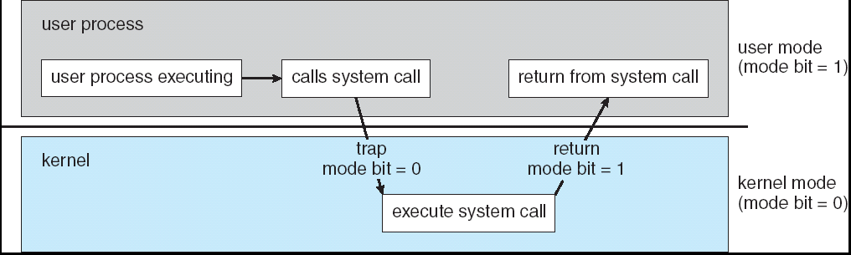
User→Kernel (System Call)
Can’t let inmate (user) get out of padded cell on own
Would defeat purpose of protection!
So, how does the user program get back into kernel?
System call: Voluntary procedure call into kernel
Hardware for controlled User→Kernel transition
Can any kernel routine be called?
No! Only specific ones.
System call ID encoded into system call instruction to lookup the system call instruction address.
Notes:
Index forces well-defined interface with kernel

Slide 87
System Call Continued
What are some system calls?
I/O: open, close, read, write, lseek
Files: delete, mkdir, rmdir, truncate, chown, chgrp, ..
Process: fork, exit, wait (like join)
Network: socket create, set options
Are system calls constant across operating systems?
Not entirely, but there are lots of commonalities
Also some standardization attempts (POSIX)
What happens at beginning of system call?
On entry to kernel, sets system to kernel mode
Handler address fetched from table/Handler started
System Call argument passing:
In registers (not very much can be passed)
Write into user memory, kernel copies into kernel mem
User addresses must be translated!
Kernel has different view of memory than user
Every argument must be explicitly checked!

Slide 88
User→Kernel (Exceptions: Traps and Interrupts)
A system call instruction causes a synchronous exception (or “trap”)
In fact, often called a software “trap” instruction
Other sources of synchronous exceptions:
Divide by zero, Illegal instruction, Bus error (bad address, e.g. unaligned access)
Segmentation Fault (address out of range)
Page Fault (for illusion of infinite-sized memory)
Interrupts are Asynchronous Exceptions
Examples: timer, disk ready, network, etc….
Interrupts can be disabled, traps cannot!
On system call, exception, or interrupt:
Hardware enters kernel mode with interrupts disabled
Saves PC, then jumps to appropriate handler in kernel
For some processors (x86), processor also saves registers, changes stack, etc.
Actual handler typically saves registers, other CPU state, and switches to kernel stack
Notes:
Analogy: has to be a dead man’s switch – if patient cuts its wrists (segmentation fault) hw just jumps back to the warden.
Warden says “Why am I here? Oh, there’s blood all over the wall! The patient must have just killed itself”
This is just a core dump – copy the contents of the room to see what happened

Slide 89
Example Application–Kernel Interaction
Shells and UNIX fork
Shell runs as user program (not part of kernel!)
Prompts user to type command
Does system call to run command
Nachos system call is “exec,” but UNIX is different
UNIX idea: separate notion of fork vs. exec
Fork – Create a new process, exact copy of current one
Exec – Change current process to run different program
To run a program in UNIX:
Fork a process
In child, exec program
In parent, wait for child to finish

Slide 90
Example: Application–Kernel Interaction (cont’d)
UNIX fork:
Stop current process
Create exact copy
Put on ready list
Resume original
Original has code/data/stack. Copy has same!
Child process:
Exec program:
Stop process
Copy new program over current one
Resume at location 0
Why copy everything so you can discard it?
Optimization: copy-on-write, copy a page only when it’s written to
Notes:
What happens when child starts running? Does same thing as parent!
Copying allows I/O (pipes, redirection, …) to be set up between fork and exec. Child can access shell data structures to see if there is any I/O redirection and set it up before exec.
Nachos combines fork and exec into one operation.
Does this work?
UNIX changes one register in child before resume

Slide 91
Agenda
Virtual Memory Intro
Page Tables
Translation Lookaside Buffer
Demand Paging
System Calls
Summary

Slide 92
Summary #1
Virtual Memory supplies two features:
Translation (mapping of virtual address to physical address)
Protection (permission to access word in memory)
Most modern systems provide support for all functions with a single page-based system
All desktops/servers have full demand-paged Virtual Memory
Portability between machines with different memory sizes
Protection between multiple users or multiple tasks
Share small physical memory among active tasks
Hardware support: User/Kernel Mode for protection
Notes:
invoke Supervisor Mode, TLB, Page Table Register

Slide 93
Summary #2
PTE: Page Table Entries
Includes physical page number
Control info (valid bit, writeable, dirty, user, etc)
A cache of translations called a “Translation Lookaside Buffer” (TLB)
Relatively small number of entries (< 512)
Fully Associative (Since conflict misses expensive)
TLB entries contain PTE and optional process ID
Notes:
No fancy replacement policy is needed for the direct mapped cache.
As a matter of fact, that is what cause direct mapped trouble to begin with: only one place to go in the cache--causes conflict misses.
No fancy replacement policy is needed for the direct mapped cache.
As a matter of fact, that is what cause direct mapped trouble to begin with: only one place to go in the cache--causes conflict misses.
Besides working at Sun, I also teach people how to fly whenever I have time.
Statistic have shown that if a pilot crashed after an engine failure, he or she is more likely to get killed in a multi-engine light airplane than a single engine airplane.
The joke among us flight instructors is that: sure, when the engine quit in a single engine stops, you have one option: sooner or later, you land. Probably sooner.
But in a multi-engine airplane with one engine stops, you have a lot of options. It is the need to make a decision that kills those people.

Slide 94
Summary #3
On TLB miss, page table must be traversed
If located PTE is invalid, cause Page Fault
On context switch/change in page table
TLB entries must be invalidated (If ProcessID is not contained)
TLB is logically in front of cache
But can be overlapped with cache access in some cases

Slide 95
Quiz: True or False
Each process must have its own Page Table.
True. Each VPN in each address space must have its own mapping.
Notes:
B) Statements 1 and 2 are false; 3 is true

Slide 96
Quiz I: True or False
A program tries to load a word at X that causes a TLB miss but not a page fault. Which are True or False:
1. A TLB miss means that the page table does not contain a valid mapping for virtual page corresponding to the address X
2. There is no need to look up in the page table because there is no page fault
3. The word that the program is trying to load is present in physical memory.
Red) 1 F, 2 F, 3 F | Purple) 1 T, 2 F, 3 F
Blue) 1 F, 2 F, 3 T | White) 1 T, 2 F, 3 T
Green) 1 F, 2 T, 3 F
Yellow) 1 F, 2 T, 3 T
Notes:
B) Statements 1 and 2 are false; 3 is true

Slide 97
Quiz II
Consider a processor with 32-bit virtual addresses, and 28-bit real addresses.
A 4-way set associative cache that can hold 512 cache blocks; cache block size is 128 Bytes
A 2-way set associative TLB with 64 entries; memory page size is 4096 Bytes.
The cache is physically addressed and memory references use byte addressing. Describe in detail the steps involved in processing a load instruction which results in a TLB hit and a cache hit.
Notes:
Your description should tell exactly which bits of the physical and virtual addresses are used for each step, how long the tags are, and so on.

Slide 98
TLB and Cache Both Hit
Cache Tag:Index:Offset is 14:7:7 (physical memory address is 28 bits)
Offset =7 bits since the cacheline size is 128=2^7 Bytes; Index=7 bits since there are 512/4 = 128 = 2^7 sets (each set has 4 cache blocks). The remaining higher-order bits are the Tag=28-(7+7)=14
TLB Tag:Index:Offset is 15:5:12 (virtual memory address is 32 bits)
Offset=12 bits since the page size is 4096 = 2^12 Bytes; Index=5 bits since there are 64/2 = 32 = 2^5 sets in the TLB (each set has 2 entries). The remaining high-order bits are the Tag = 32-(5+12)=15. The physical page number in each TLB entry is 28-12=16 bits.
We first look up the memory address in the TLB. We use the index field, bits 16-12 (numbering from 31 for the left-most bit and 0 for the right-most one), to index into the TLB. There are two entries at this index (since the TLB is 2-way set associative) - we check to see if either entry there has a tag field that matches the 15 bit tag of the virtual address (bits 31-17). We are told that this is a TLB hit, so one of the two entries in this set matches the tag (and the corresponding valid bit is "1"). So we take the 16 bit PPN in the TLB and prepend it to the 12 bit offset of the virtual address to form the 28 bit physical address.
Now we need to use this physical address to look up the data in cache. We use the index (bits 7-13 of the physical address) to choose a set, and compare the tag (bits 27-14 of the physical address) to the 4 tags stored in the chosen set. Again, we are told it is a cache hit, so the corresponding line in cache has the desired data. We use the offset field (bits 0-6) of the physical address to tell us which byte in the cache block is the first byte of the data that we are looking for.
Notes:
We first need to look the address up in the TLB. To do so, we partition the address (from left to right) into a 15 bit tag, a 5 bit index, and a 12 bit offset. Note that we make the offset 12 bits since the page size is 4096 = 2^12 Bytes, and we make the index 5 bits since there are 64/2 = 32 = 2^5 sets in the TLB (each set has two entries). The remaining high-order bits are the tag. Thus, we use the index field, bits 16-12 (numbering from 31 for the left-most bit and 0 for the right-most one), to index into the TLB. There are two entries at this index (since the TLB is 2-way set associative) - we check to see if either entry there has a tag field that matches the 15 bit tag of the virtual address (bits 31-17). We are told that this is a TLB hit, so one of the two entries in this set matches the tag (and the corresponding valid bit is "1"). So we take the 16 bit physical page number in the TLB and prepend it to the 12 bit offset of the virtual address to form the 28 bit physical address.
Now we need to use this physical address to look up the data in the data cache. To do so, we partition the 28 bit physical address into (from the left) a 14 bit tag, a 7 bit index, and a 7 bit offset. (The offset is 7 bits because the cacheline is 128=2^7 Bytes long; the index is 7 bits because there are 512/4 = 128 = 2^7 sets of 4 cachelines each). We use the index (bits 7-13 of the physical address) to choose a set, and compare the tag (bits 27-14 of the physical address) to the four tags stored in the chosen set.
Again, we are told it is a cache hit, so the corresponding line in cache has the desired data. We use the offset field (bits 0-6) of the physical address to tell us which byte in the cacheline is the first byte of the data that we are looking for.
In the case of cache and TLB misses, we start out as before, but don't find the desired virtual address in the TLB. Thus, we must use the virtual page number (bits 31-12 of the virtual address) to index into the page table. There we find the physical page number. Let's assume the "valid" bit in the page table is set to "1", meaning the page actually is in main memory. (If not, we need to invoke the operating system to go off to disk and find it). So we form the physical address from the 16 bit physical page number (in the page table) concatenated with the 12 bit offset. We also bring this information into the TLB using the TLB index described earlier. Again, we break the physical page number into tag-index-offset as described earlier, look for the data in cache, and don't find it. Thus, we go to main memory and bring into cache the line that holds the desired data, kicking out the least recently used of the four cachelines that are in the set at the referenced index. If that line happens to be dirty, we must also write it back to memory.

Slide 99
TLB and Cache Both Miss
In the case of cache and TLB misses, we start out as before, but don't find the desired virtual address in the TLB. Thus, we must use the virtual page number (bits 31-12 of the virtual address) to index into the page table. There we find the physical page number. Let's assume the "valid" bit in the page table is set to "1", meaning the page actually is in main memory. (If not, we need to invoke the operating system to go off to disk and find it). So we form the physical address from the 16 bit physical page number (in the page table) concatenated with the 12 bit offset. We also bring this information into the TLB using the TLB index described earlier. Again, we break the physical page number into tag-index-offset as described earlier, look for the data in cache, and don't find it. Thus, we go to main memory and bring into cache the block that holds the desired data, kicking out the least recently block in the set at the referenced index. If the replaced block happens to be dirty, we must also write it back to memory.

